Slide 1
Four Wheel Drive Robot
Session-28

Slide 2
Session Outline
How is the Four Wheel Driver Robot assembled.
How are four-wheel-drive robots different from simple robots.
How to control the actions of the robot.
Make a Four Wheel Drive Robot.

Slide 3
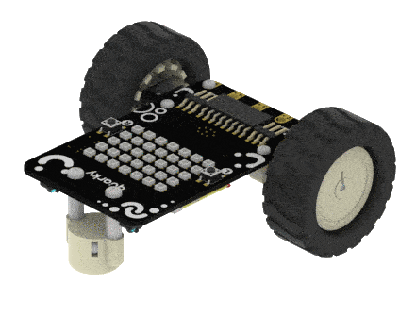
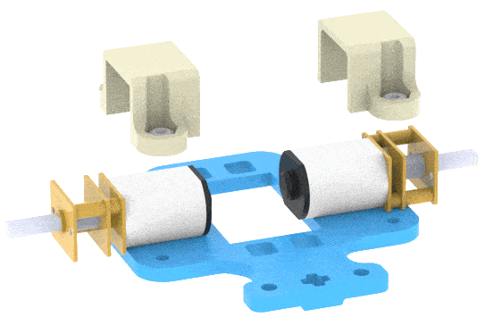
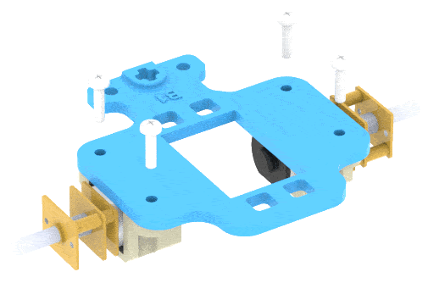
Assembling the Robot
We are starting with the Horizontal Robot:
First, detach the Castor Wheel from the Quarky Robot by removing the Bolt.
Place the Motors on the top of the B1 Plate using the Motor Mount Bracket. Fasten it using M2 Bolt and M2 Nut that you get with Motors.

Slide 4
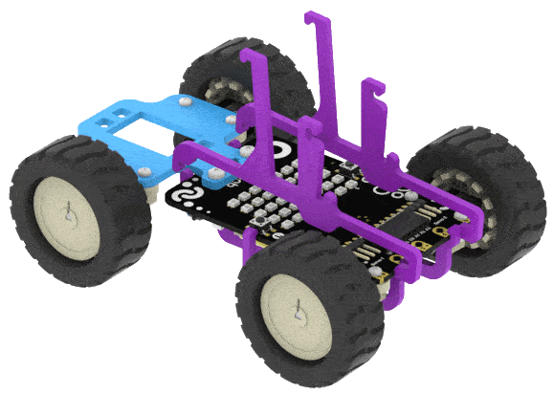
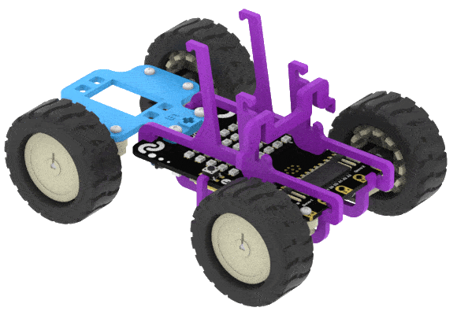
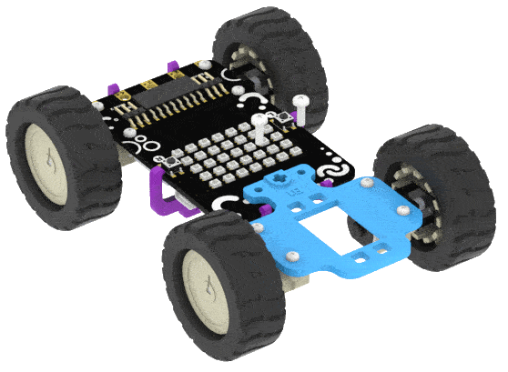
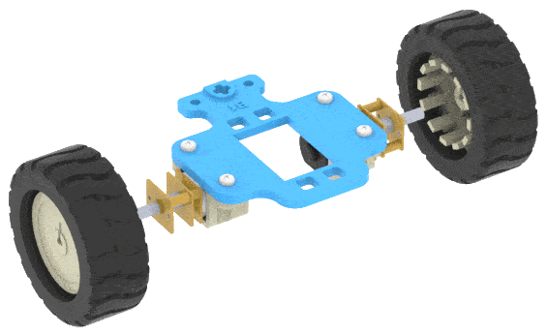
Continue..
Now attach the Wheels to the Motors.
After that, attach the Wheel sub-assembly (with wheels) in front of the Robot. Fasten it using M2.5 Nuts and Bolts.
To place a phone on the robot, mount two A3 Links on the Robot and snap it gently.
Lock the A3 Links using the A4 Link.

Slide 5
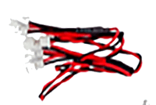
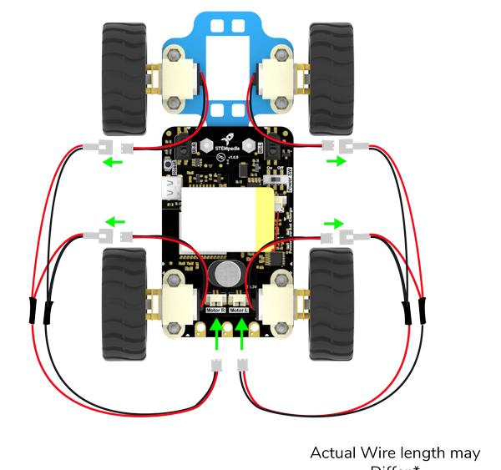
Motor Connection
The motor connection is similar to the Steering Robot.
Connect the two left motors and then connect the wire to the Board.
Do the same for the right motors.

Slide 6
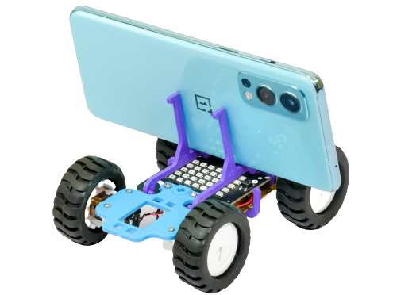
Our robot is ready.

Slide 7
Understanding Four Wheel Drive Robot

Slide 8
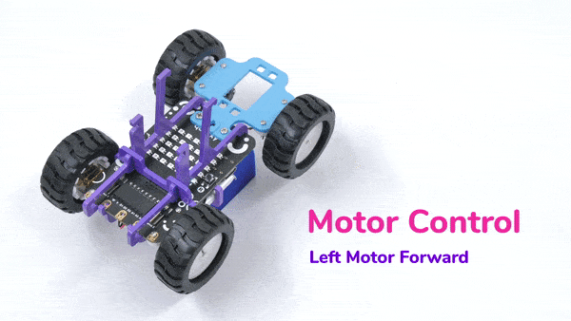
Motor Controls
The Four Wheel Drive Robot has two controls – Left Motor and Right Motor.
Since both the motors on either side are connected, they both move in a similar way.
Also, each motor has two parameters:
  Direction – Forward or Backward.
  Speed – 0 to 100.

Slide 9
Robot Motion

Slide 10
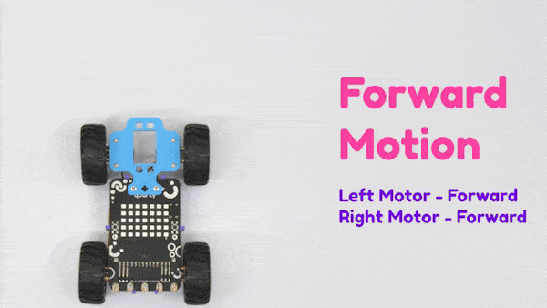
1. Forward

Slide 11
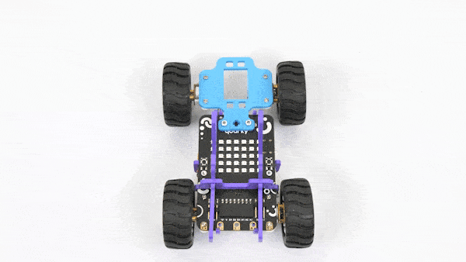
2. Left Right Motion

Slide 12
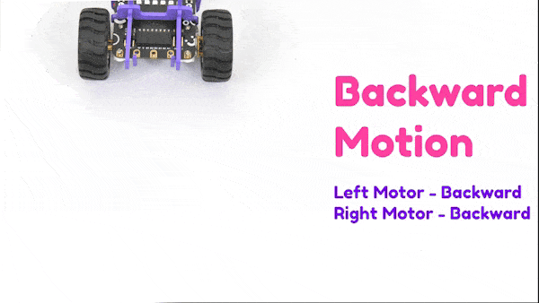
3. Backward Motion

Slide 13
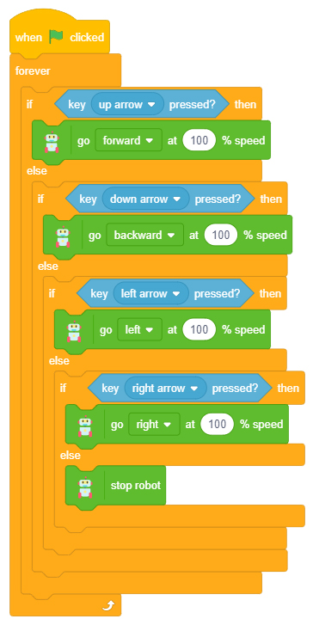
Let’s Code
The code is similar to the Wireless Controlled Robot in the last course. Make the script as shown:
Block | Palette
when flag clicked | Events
forever | Control
if () else | Control
key () pressed? | Sensing
go () at () % speed | Robot
stop robot | Robot
Run the script by clicking on the green flag above the stage.

