Slide 1
Working with Conditions
Session 4

Slide 2
What is Condition?
Life is full of conditions: A conditional statement is represented in the form of “if…then” and “if…then…else”.
These statements allow the program to check the conditions by testing a variable against a value and act accordingly.
A program that has conditional statements is called a Conditional Program, and the process is known as Conditional Programming.

Slide 3
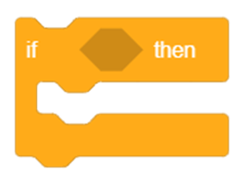
if () then Block:
The if () then block will check whether the specified condition is true or not.
If it is true, the blocks inside it will run, and then the script involved will continue.
If the condition is false, the code inside the block will be ignored and the script will move on. The condition is checked only once.

Slide 4
If () Then Block
We're going to make a script that will make Tobi glide to a random position on the Stage whenever we press the space key.

Slide 5
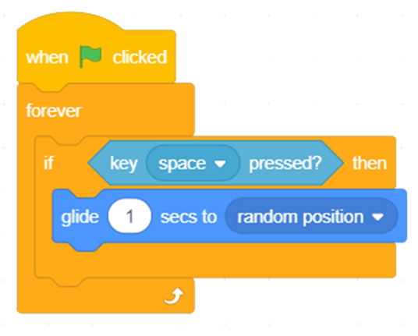
Add an if () then block.
Place a key () pressed? block in the space of the if block
Place glide to () seconds blocks under the if arm.
Place a forever block around the if () then block.
Add a when flag clicked block above to complete the script

Slide 6
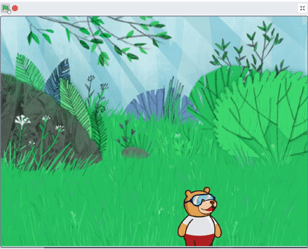
Final Output
Click the flag when done and press the space key.

Slide 7
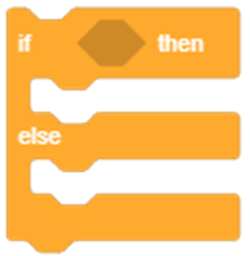
If () then Else Block
The if () then else block will check whether the specified condition is true or not.
If the condition is true, the code held inside the first C (below the if arm) will run. Then, the script will continue.
If the condition is false, the code inside the second C (below the else arm) will run. (unlike the if () then block).

Slide 8
If () then Else Block
We're going to make a script that will make Tobi move towards the mouse cursor whenever we click it.
When we're not clicking it, he should go back to his default position in the center.

Slide 9
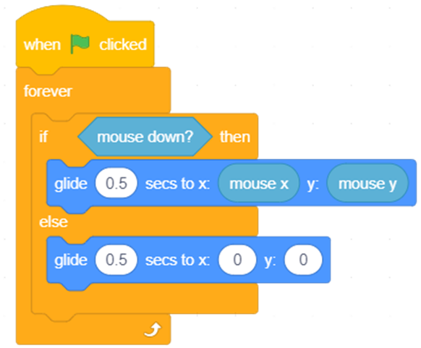
Add an if-else block and place a mouse-down? block in the space of the if arm.
If it is true, Tobi should glide towards the mouse. Therefore, add a glide () secs to x: () y: () block and place mouse x and mouse y in their respective white spaces.
If the condition is false, it will stay at the center. Thus, place another glide () secs to x: () y: () block and write set x and y value to 0.
Add a forever block to run the script continuously.
Add a when flag clicked block to run the script.

Slide 10
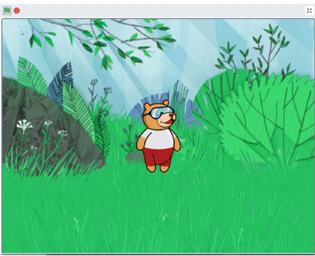
Final Output
Click the flag when done and press the mouse.

