Slide 1
Let’s Chat!
Session 4

Slide 2
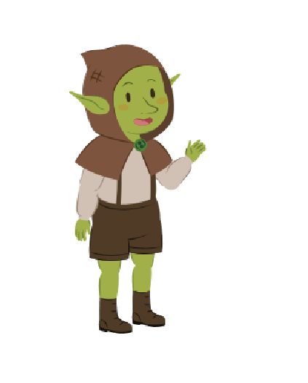
Let’s Chat!
In this activity, we will learn how to ask the user to enter input and create a script where a friendly goblin has a small chat with the user.

Slide 3
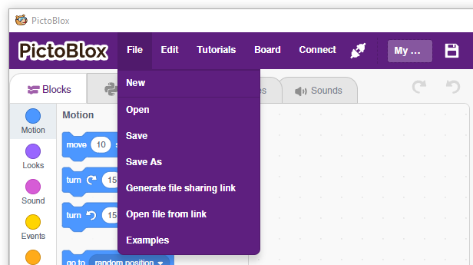
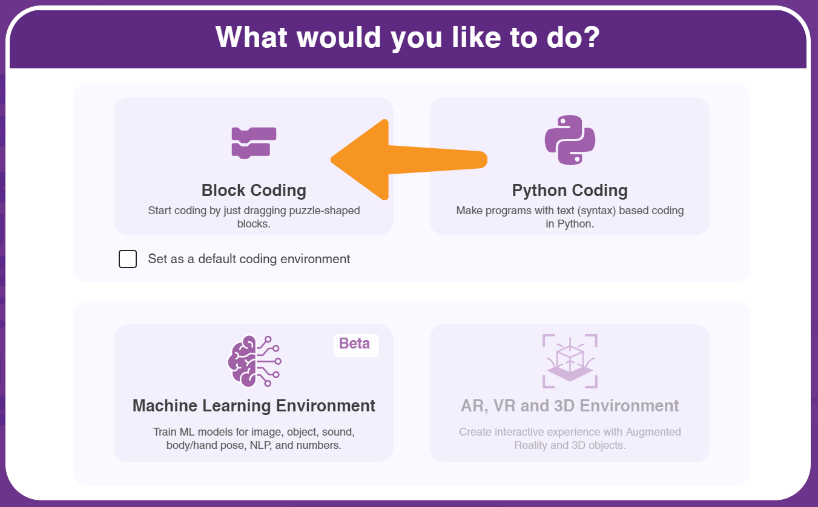
Let’s Code !
To begin, follow the steps below:
  Open PictoBlox.
  Create a New file in PictoBlox.
Follow the step if you are working on Windows, macOS, or Linux:
  Open PictoBlox and create a new file.
  Select the coding environment as Block Coding.

Slide 4
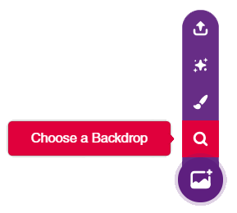
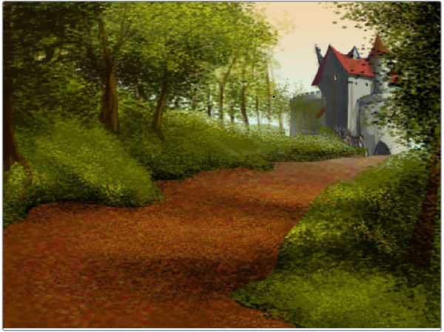
Choosing the Backdrop
Follow the steps below to add a backdrop.
Click the Choose a Backdrop button.
Select the Castle 2 backdrop from the library.

Slide 5
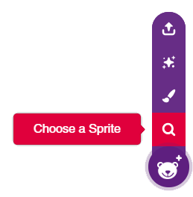
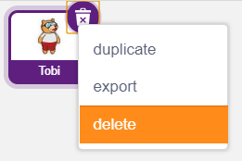
Choosing the Sprite
Using choose a sprite button, Choose the Globin sprite.
Right-click on the Tobi icon in the sprite palette and delete it.

Slide 6

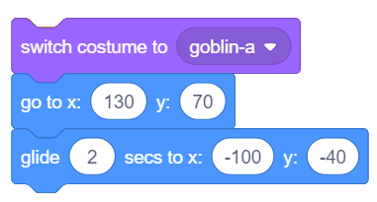
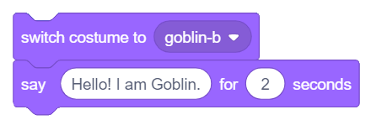
Let’s Code
Let’s start making the script.
To make the Goblin Glide drag and drop the following blocks into the scripting area.
  when flag clicked – Events
  switch costume to () – Looks
  go to x: () y: () – Motion
  glide () secs to x: () y: () – Motion
  For switching costume and saying drag the below blocks into the scripting area.
  switch costume to () – Looks
  say () for () Secs – Looks

Slide 7
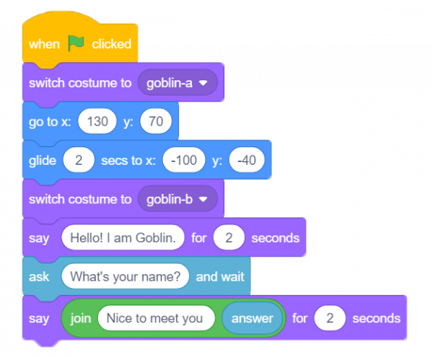
Let’s Code
Drag and drop the below blocks to make the Goblin ask a question and reply to the user’s response.
  ask () and wait – Sensing
  say () for () seconds – Looks
  join () () – Operators
  answer – Sensing

Slide 8
Let’s Code
The complete script looks like this
Final Script

Slide 9
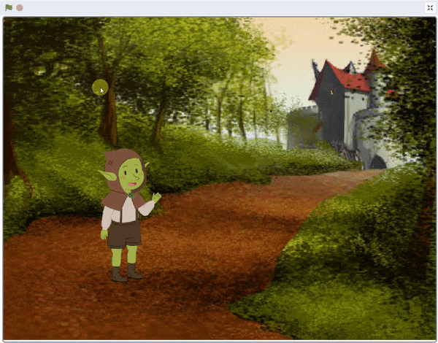
Let’s Code
Now it’s time to save your program. Save the project file as Let’s Chat.
Enjoy!!

