Slide 1
Introduction to Pictoblox
Session 1

Slide 2
What is a Program?

Slide 3

What is a Program?
A program is a set of instructions that a computer follows to complete a task.
The computer receives a set of instructions (program) which it interprets and follows step by step, to produce the required output in order to accomplish a given task.

Slide 4
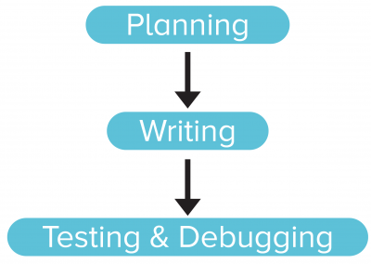
What is a Program?
Programming consist of three parts:
  Planning the program
  Writing the program in a programming language
  Testing and debugging the program

Slide 5
Programming Analogy:
Getting Dressed for School

Slide 6

Analogy – How to change dress?
Taking off the pajamas.
Taking off the undergarments from the previous day.

Slide 7
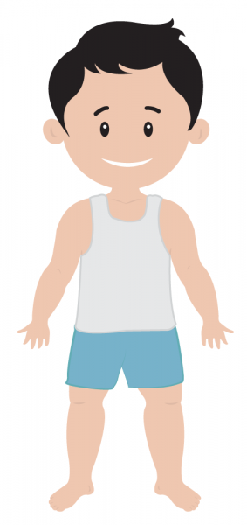
Analogy – How to change dress?
Wearing a fresh pair of undergarments.
Putting on the school uniform.

Slide 8

Analogy – How to change dress?
Wearing your accessories such as the belt, tie and ID card.
Finally, wearing socks and shoes.
Here, as you can see, you followed a set of instructions in a specific order, to complete the task of getting dressed.

Slide 9
Analogy – How to change dress?
Similarly, you must write a program in a specific order, so that the computer does the task given to it correctly, and we can get the result that we expect.

Slide 10
All about PictoBlox

Slide 11
What is PictoBlox?
PictoBlox is a Scratch 3.0-based graphical programming software. It is the ideal companion for setting the first step into the world of programming.
It is a user-friendly interface where drag-and-drop functionality eliminates the need to memorize syntax and rules which is the case in traditional programming language.
It helps budding programmers like you, to learn how to write
a program in a fun, educational and easy way, using blocks.

Slide 12
PictoBlox Interface

Slide 13
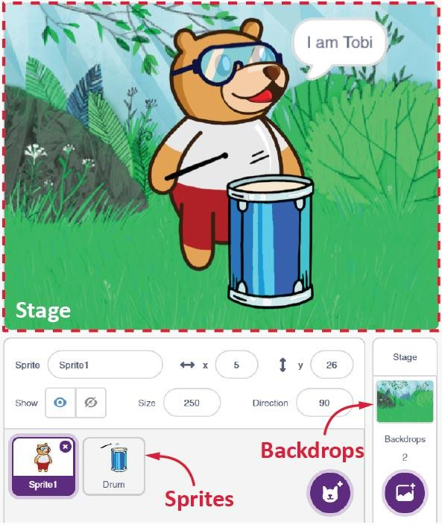
Stage
Stage is a background (also
called a backdrop) for your
Scratch projects.
The Stage is where the
sprites move, draw, and
interact with each other.

Slide 14
Sprite
A Sprite is an object or a character which performs different actions in the project.
They can be moved to any place in the stage, either by:
  Clicking on them and dragging.
  By writing a program to control them.

Slide 15
Stage Palette
Below the Stage (bottom right) is the Stage Palette. You have different tools in the Stage Palette using which you can change the Stage:
  You can choose an image from backdrop library.
  You can paint a new stag e or import an image.
  You can click a picture using your computer’s or laptop’s camera.

Slide 16
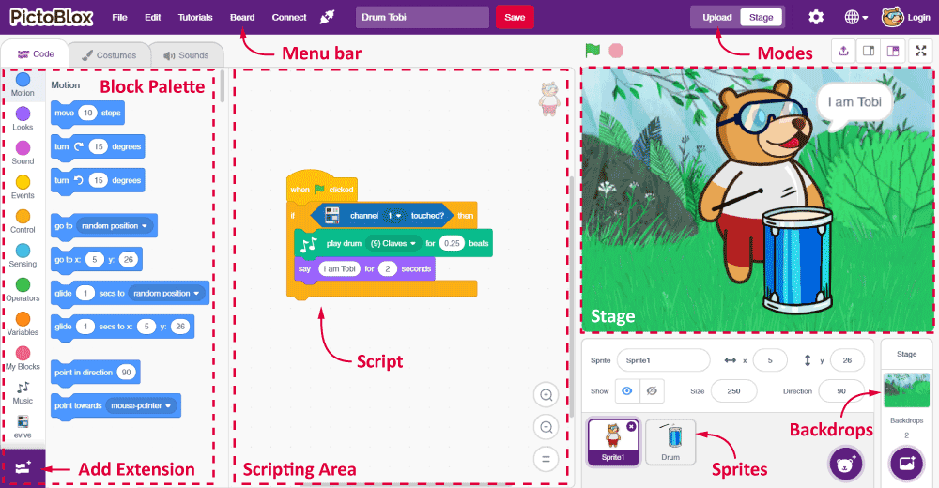
Blocks
A block is a jigsaw puzzle piece, which is used to write programs.
They can be simply dragged and dropped below one another in the scripting area to build awesome programs.

Slide 17
Block Palette
The Block palette is under the Blocks tab. It consists of different palettes such as Motion, Sound, Control etc.
Each palette has different blocks that perform functions as specified by the palette name.
E.g., blocks in the Motion palette will control motion of the sprite, and the blocks in Control palette will control the working and order of the script.

Slide 18
Script
Script is a program or code in PictoBlox/Scratch programming language.
Script is a ‘set of blocks’ that are arranged below one another, in a specific order, to perform a single task or a series of tasks.
Scripting Area is where you write the Script.

Slide 19
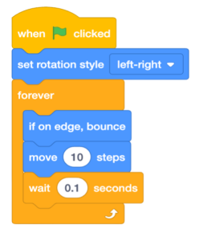
Make Tobi Move
Follow the steps below to make the script :
Run the script by clicking on the green flag above the stage.
Step | Block | Palette
1. | when flag clicked | Events
2. | Forever | Control
3. | Move () steps | Motion
4. | If on edge, bounce | Motion
5. | Wait () seconds | Control

Slide 20
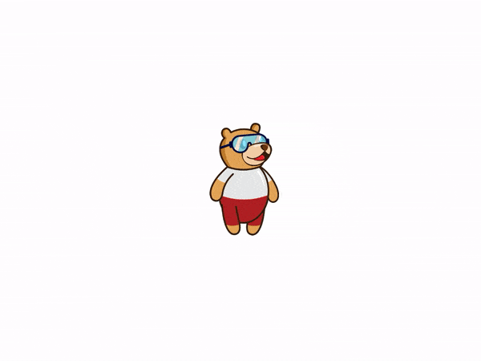
Make Tobi Move
What is happening to Tobi? Is Tobi upside down sometimes?

Slide 21
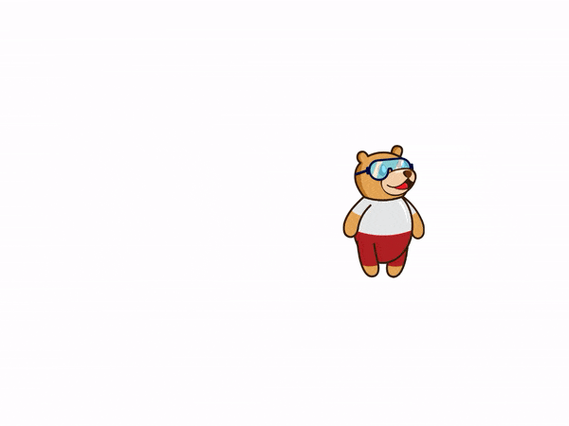
Make Tobi Move
To prevent Tobi from going upside down, we must change its rotation style.
Add a set rotation style (left-right) block from the Motion palette, below the when flag clicked block.
The program is now complete.
Run the script by clicking on the green flag.

